Slide 1


Xumm Hub Prototype
Hackathon XRPL Summer 2032 | Ripple
Ricardo M. Biot

Slide 2
Feactures
Workflow
Publish Job
Send quotation
Approve
Done
Confirm
Close
Direct Transfer
Home
Login/Logout (using Xumm)
User Profile
List Jobs

Slide 3
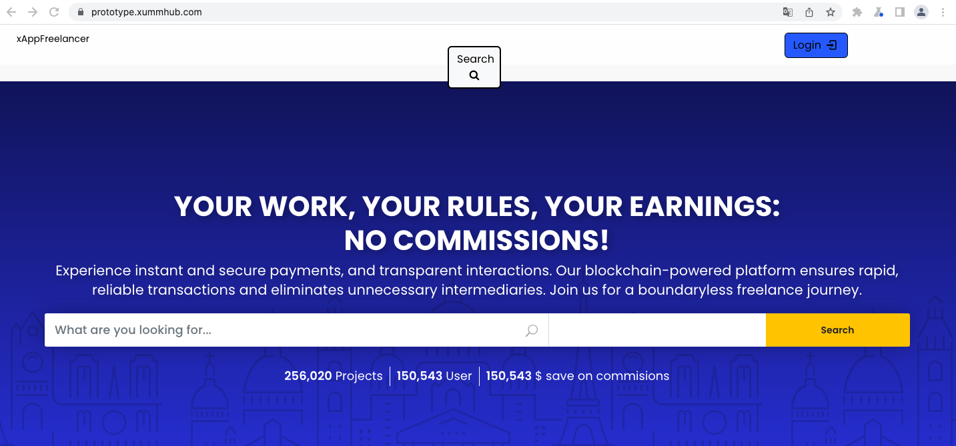
Home - https://prototype.xummhub.com/
NOT FULL FUNCTIONAL
TEMPLATE WITH
MOCKUP TEXTS

Slide 4
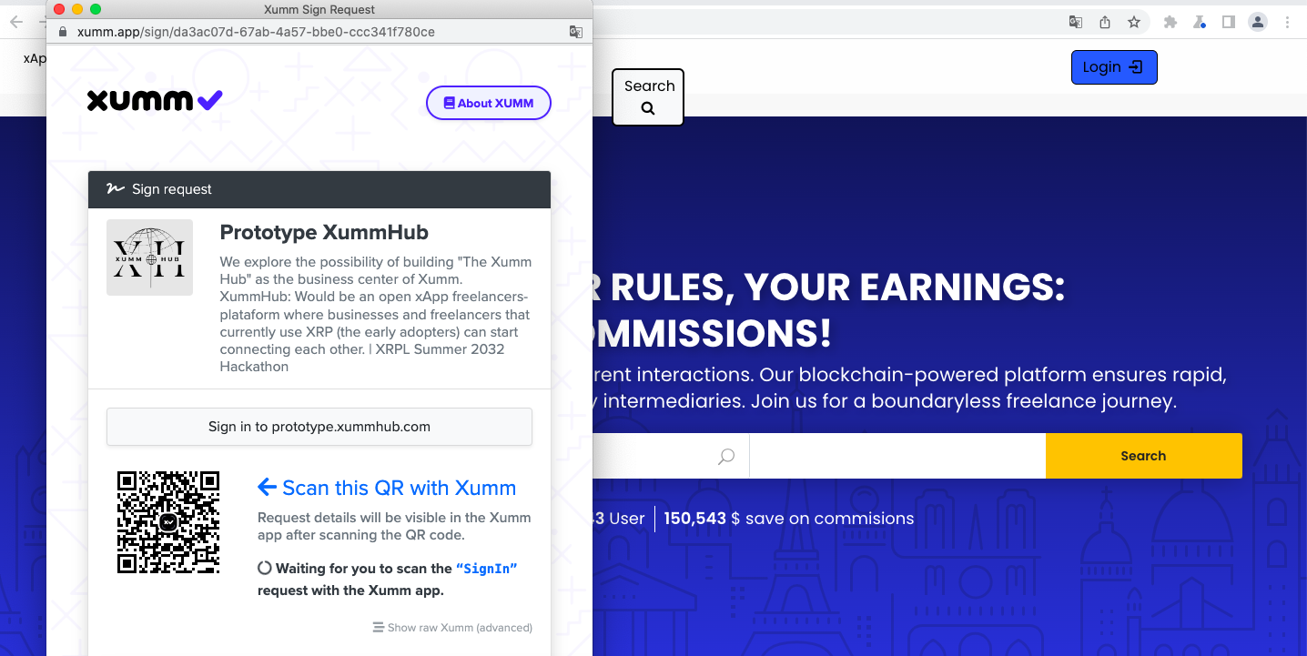
Login

Slide 5
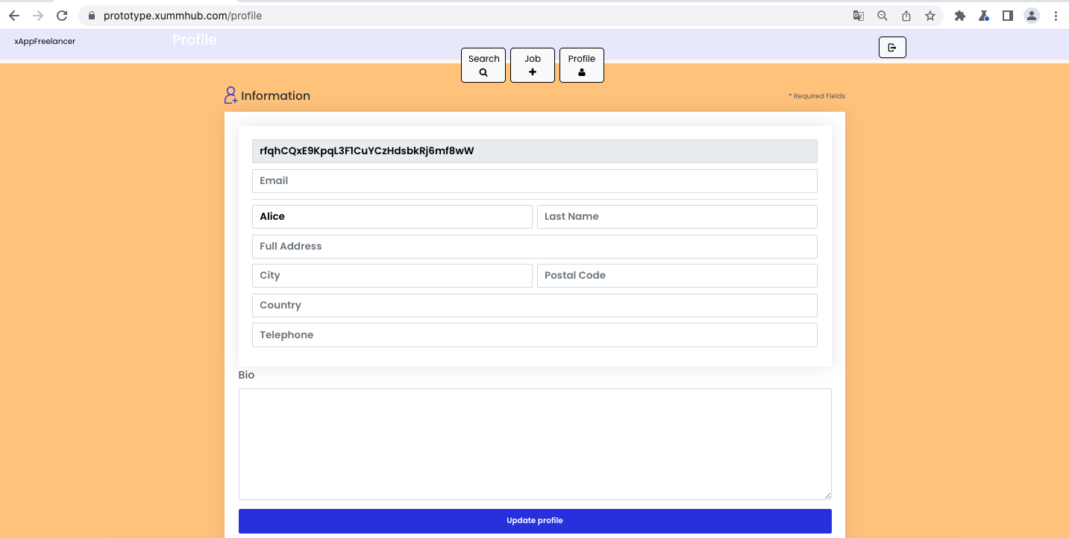
User profile

Slide 6
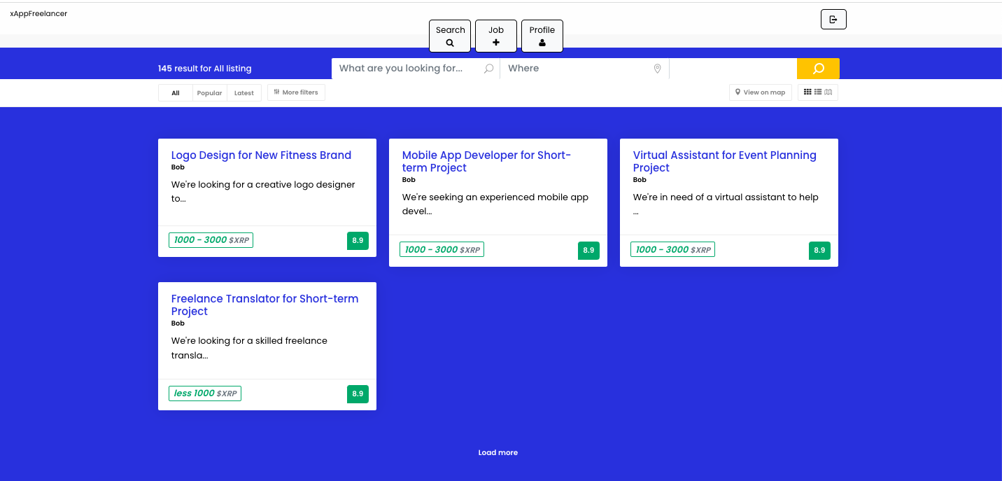
List Jobs

Slide 7
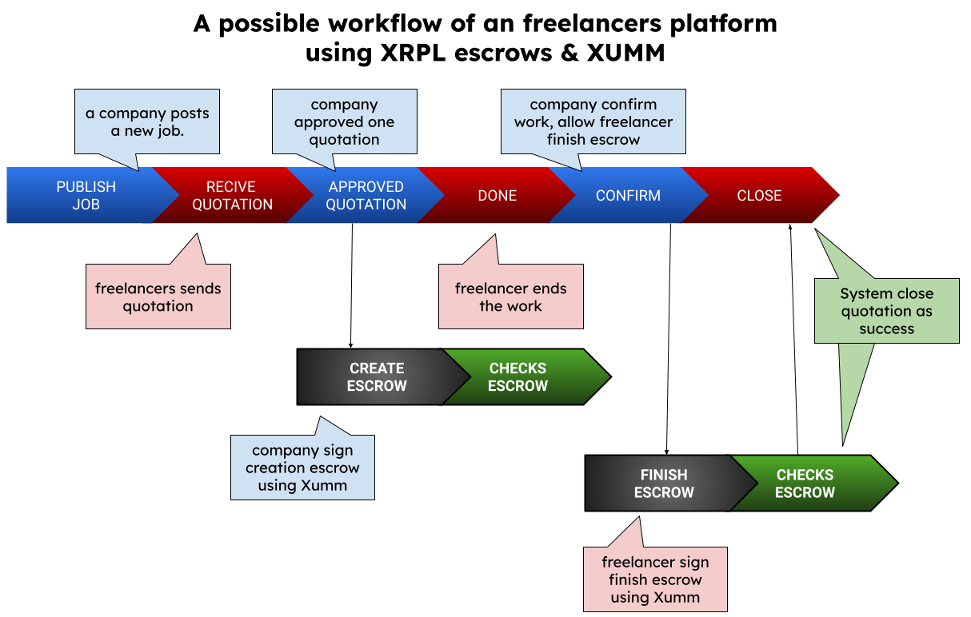
Workflow

Slide 8
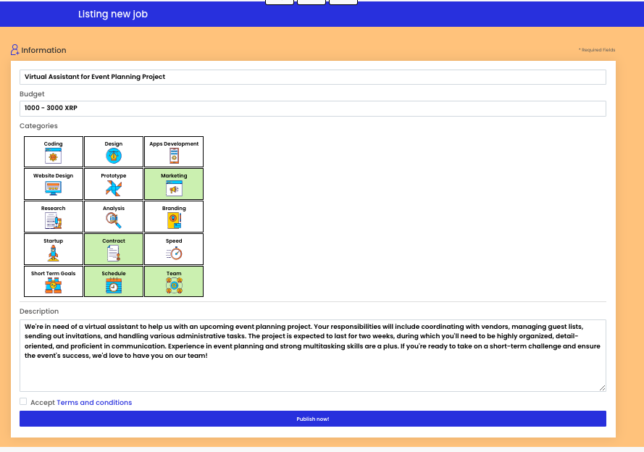
Publish job (Bob)

Slide 9
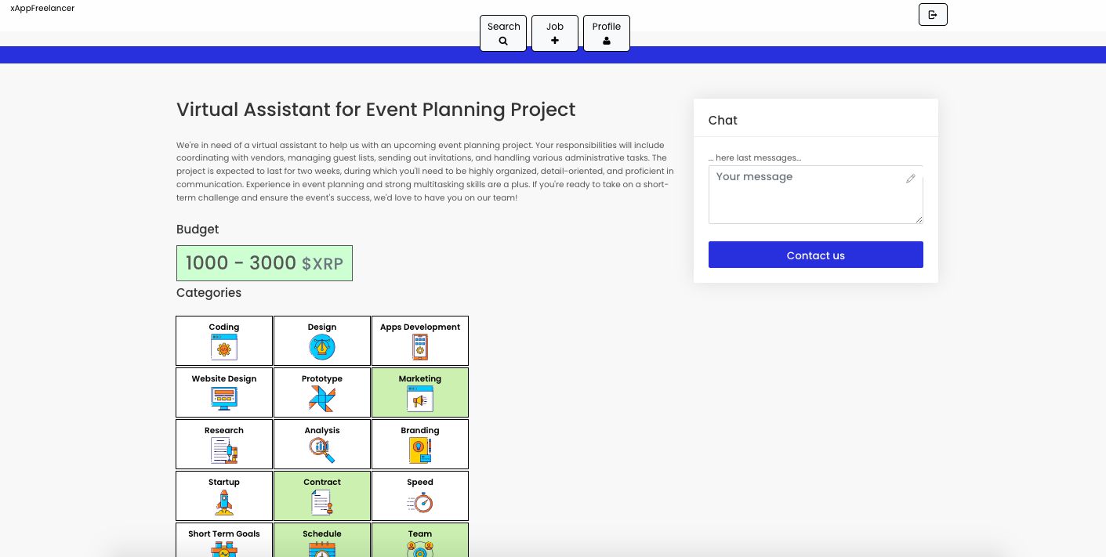
Job details (Bob)

Slide 10
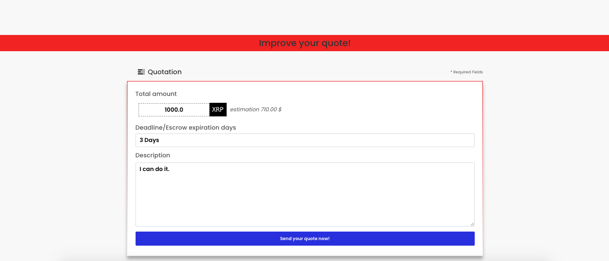
Send quote to Job (Alice)

Slide 11
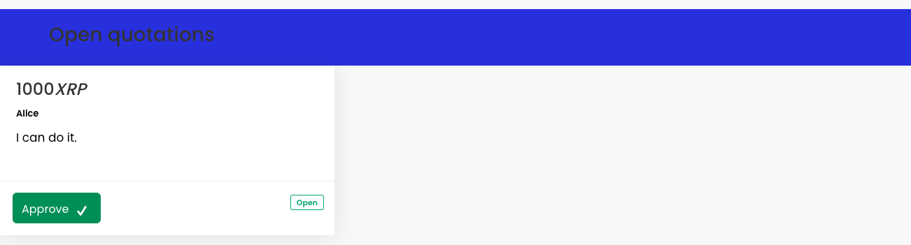
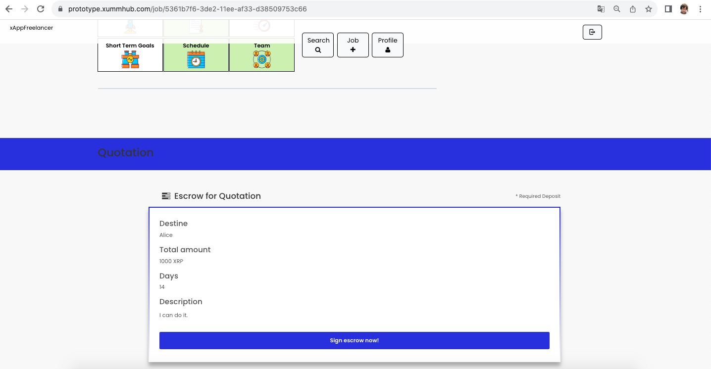
Bob approve Alice quote

Slide 12
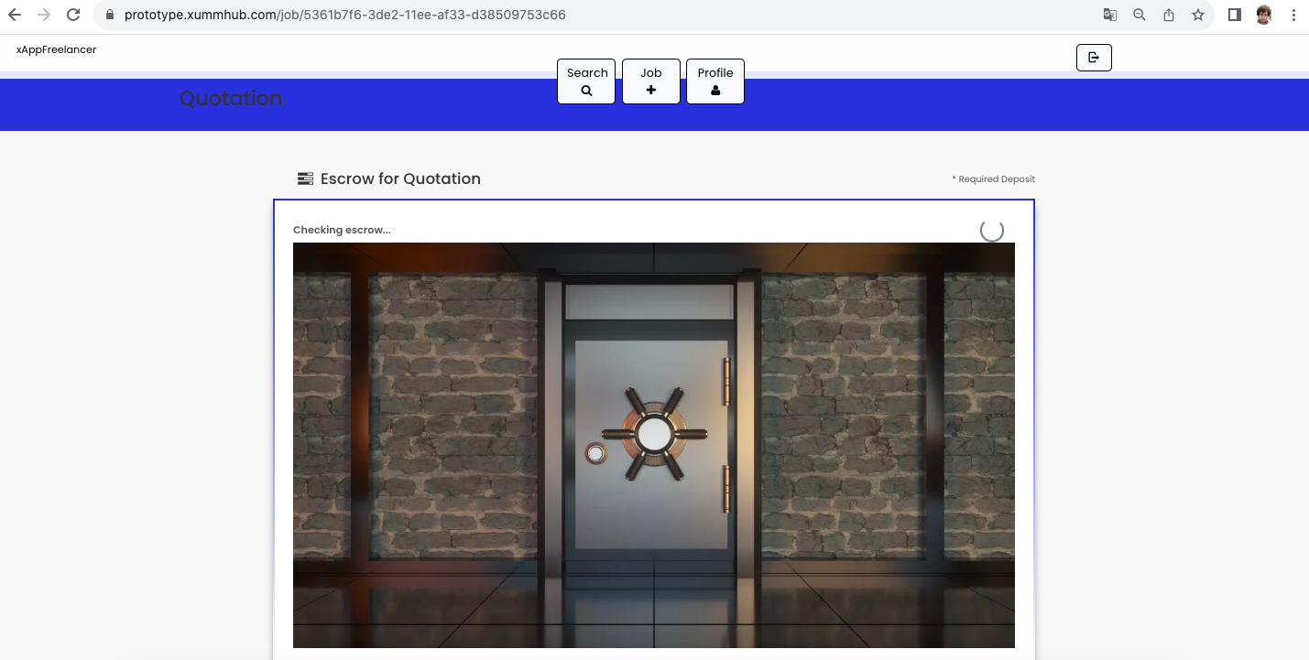
Bob signs - create escrow

Slide 13

Workflow

Slide 14
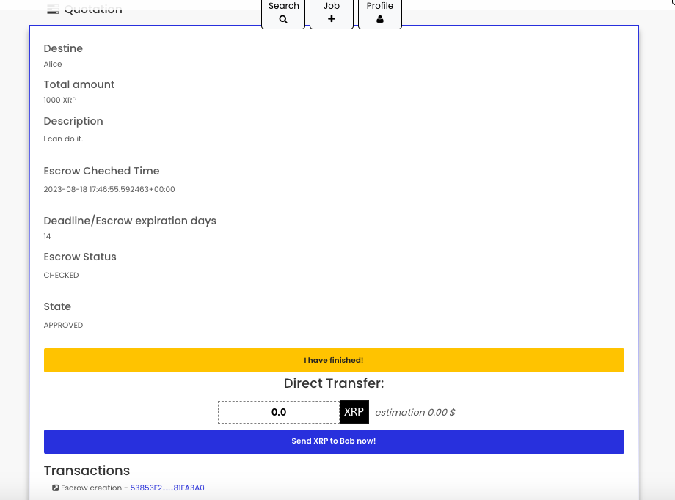
Alice finish work

Slide 15
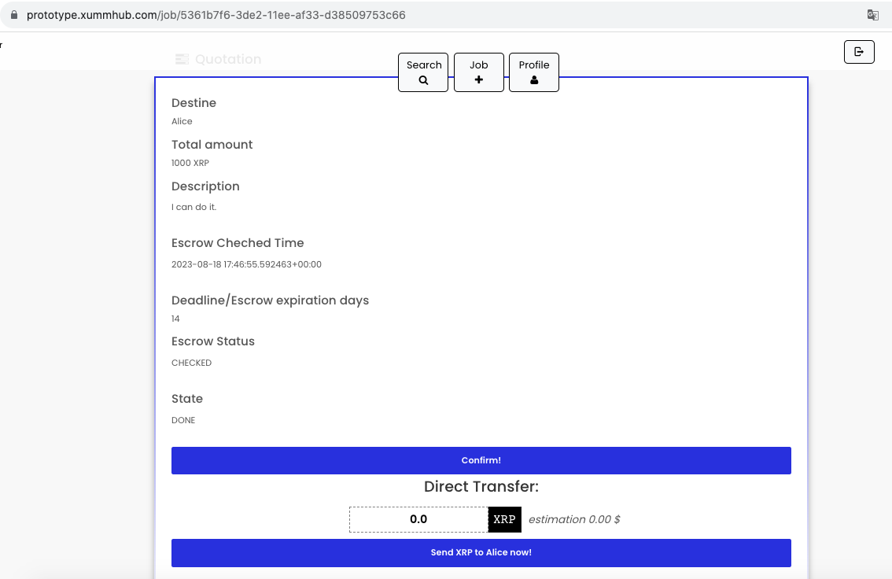
Bob confirm it

Slide 16
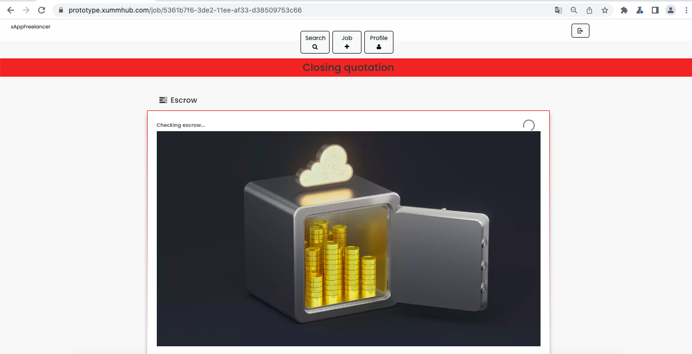
Alice signs – finish escrow

Slide 17
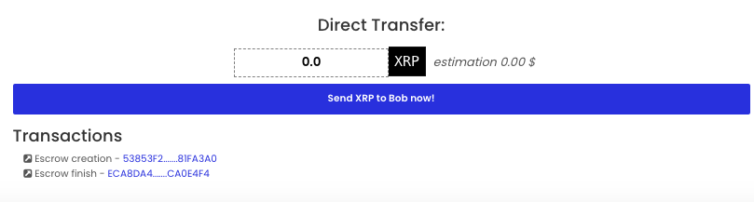
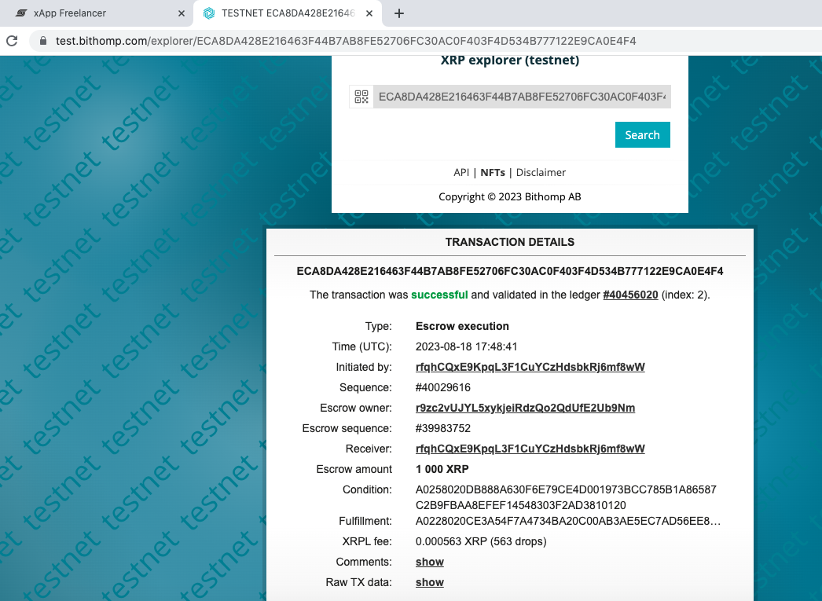
Transaction List

Slide 18
Workflow

Slide 19
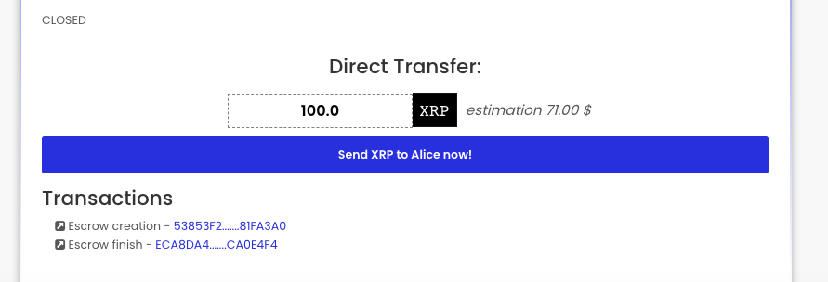
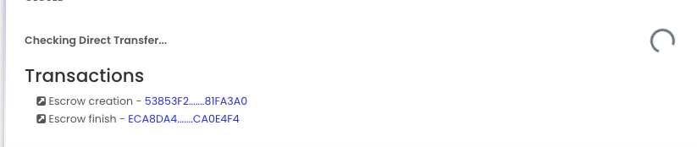
Send Direct Transfer

Slide 20
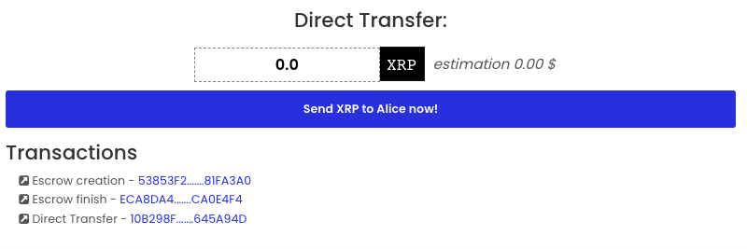
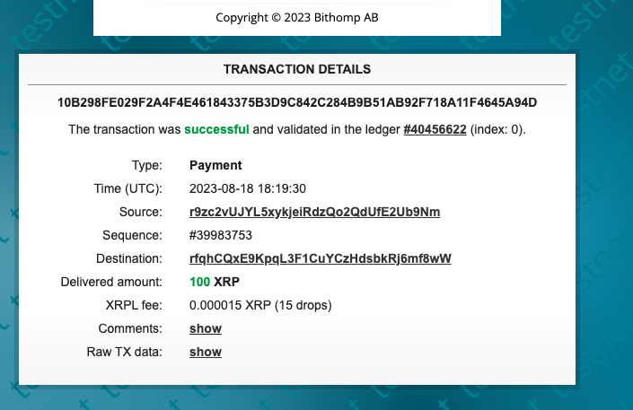
Send Direct Transfer

Slide 21
MORE ABOUT
Demo:
https://prototype.xummhub.com/
Code + Docs
https://github.com/ricardombiot/xumm_hub_prototype/
THANKS, GRACIAS, 谢谢 …

